Slide 1
Smart Health Data Mapping
From Raw Data to Insights – A Hackathon Challenge

Slide 2
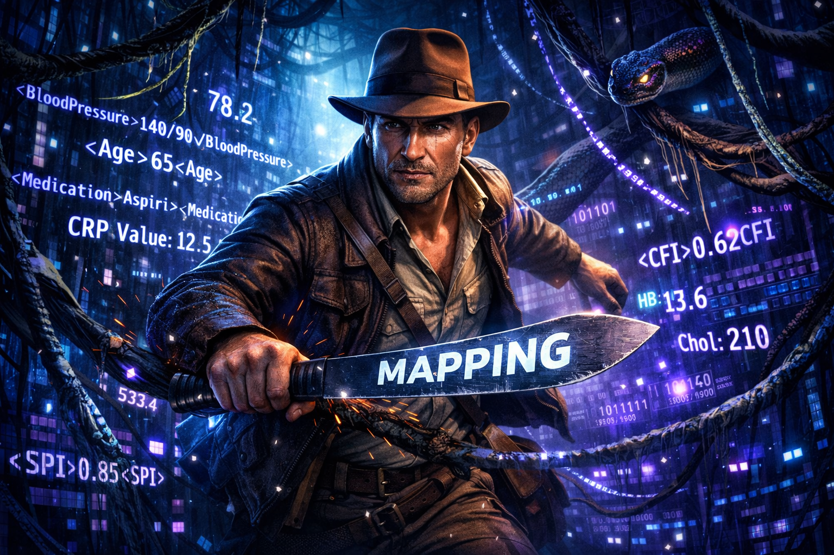

Slide 3



The Problem: Data Everywhere, But Isolated
Hospital Information Systems
Core clinical records in different formats
Lab Software
Diagnostic results in isolated databases
Excel Exports
Manual data extracts with inconsistent structure
Sensor & Free Text
Unstructured data that resists automation
Each system stores data in its own format. Combining them for analytics still requires many manual steps — making the process slow and difficult to scale.

Slide 4

This is exactly the problem we want you to solve!

Slide 5

Your mission
Build an Intelligent Application
Automatically map healthcare data from different sources into a unified data model.
Your system should handle:
Structured tables & CSV files
PDF documents
Unstructured free text
Automatically identify, align, and transform data into a consistent structure.

Slide 6
In Addition: Interactive Dashboard
Data Origin & Structure
Visualize where data comes from and how it is organized
Quality & Completeness
Surface gaps, inconsistencies, and coverage metrics
Anomaly Dectection
Automatically flag unusual patterns or outlines.
Alerts & Corrections
Alerts for mapping issues and an interface to correct errors.

Slide 7
Real-World HealthCare Data
Care Assessments
Diagnoses
Lab Parameters
Vital Signs
Medication Plans
Resource Planning

Slide 8
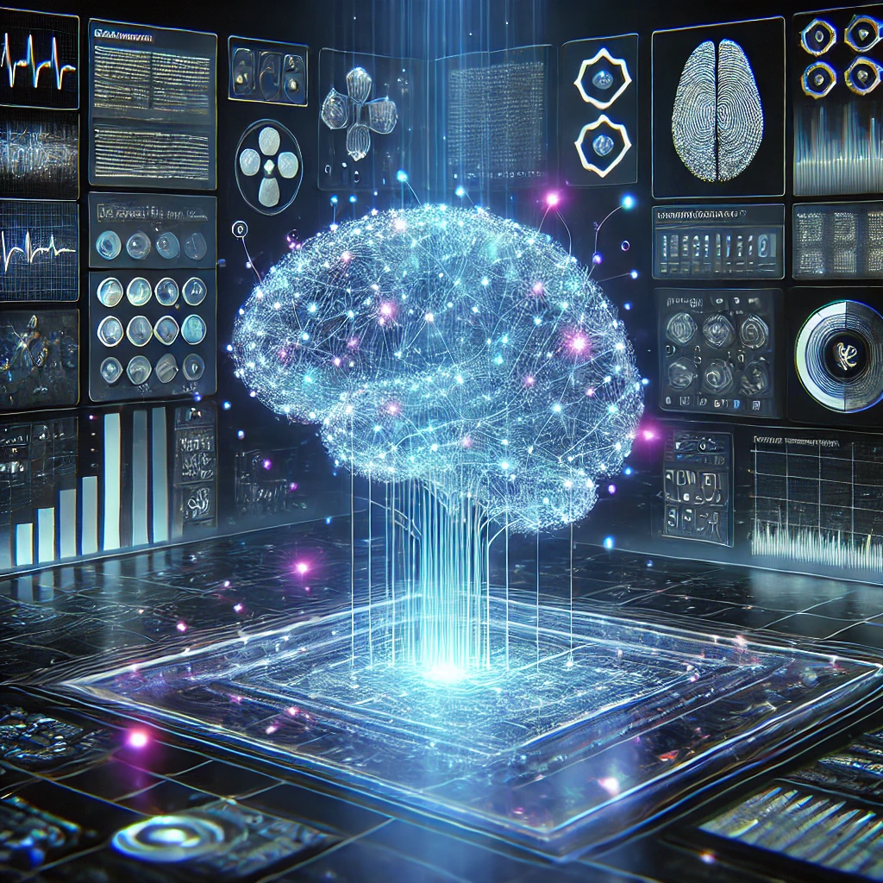
Technology: Your Choice
Freedom to Innovate
Use any approach that works –
AI, NLP, agents or rules-based logic.
One key requirement:
The solution should be deployable on-premises so healthcare data remains securely in-house.

Slide 9
Why This Matters
1,400
Institutions
Already working with data from care facilities today
630,000
Active Users
Real people whose daily work could be improved
€100B
DACH Market
Annual healthcare costs in the region
1-2%
Efficiency Gain
Could mean hundreds of millions in savings

Slide 10
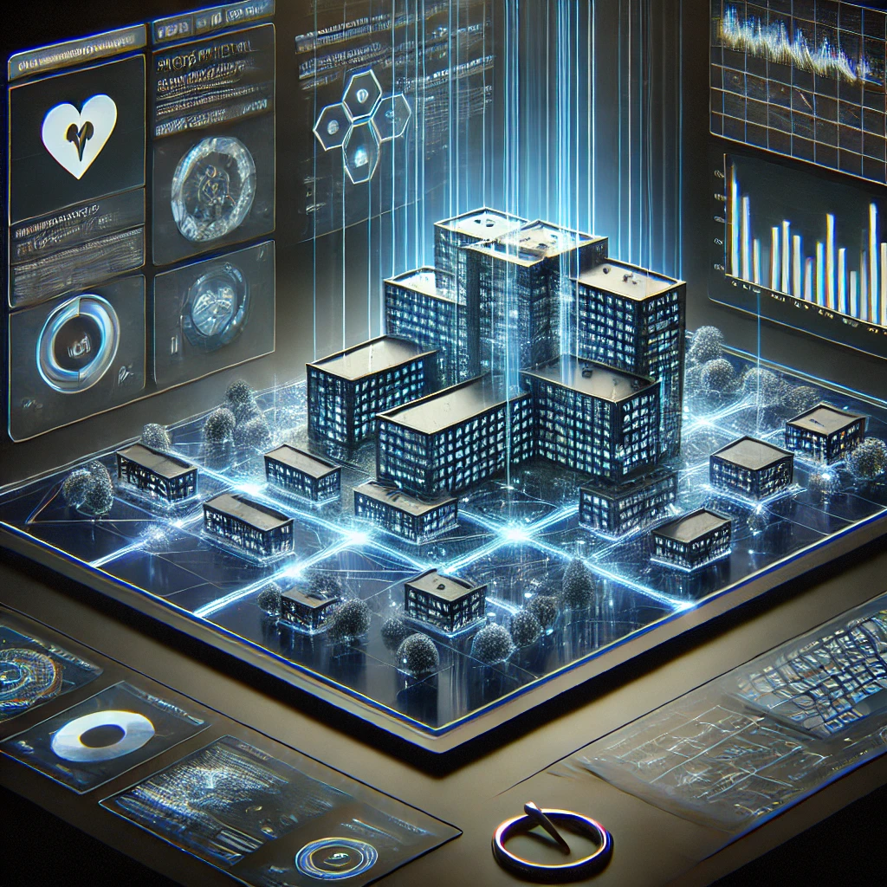
The Bigger Vision
From Data to Impact
By harmonizing healthcare data, we unlock better analytics, better models and faster innovation – ultimately building a digital twin of care situations accross the entire network.

Slide 11
Good Luck – Enjoy the Hackathon!

